Slide 1

Event Handling and Reusable Components

Slide 2
Objectives
Event Handling
Declaring event handlers
Using event handler context and parameters
Declaring inline event handlers
Binding handlers to elements
Using synthetic event objects
Understanding event pooling
Render and Commit
State as a snapshot

Slide 3
Event Handling

Slide 4
Responding to Events
React lets you add event handlers to your JSX. Event handlers are your own functions that will be triggered in response to interactions like clicking, hovering, focusing form inputs, and so on.
You will learn:
Different ways to write an event handler
How to pass event handling logic from a parent component
How events propagate and how to stop them

Slide 5
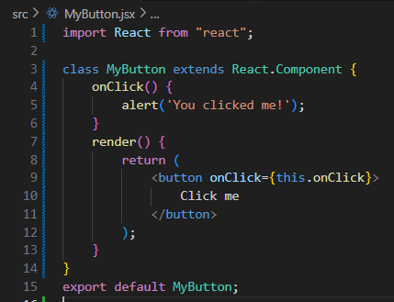
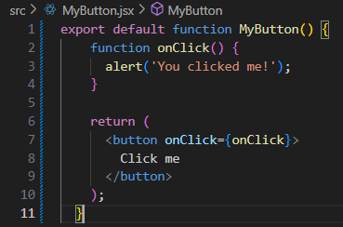
Declaring event handlers
Declaring handler functions
Notes:
Using two methods: Class or Function

Slide 6
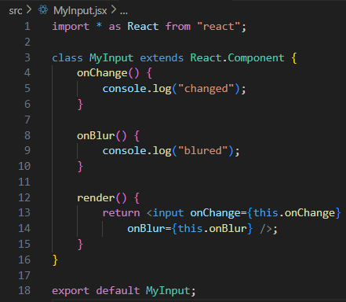
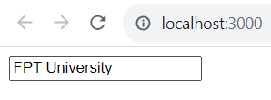
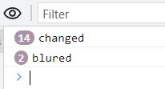
Declaring event handlers – cont’d
Multiple event handlers

Slide 7
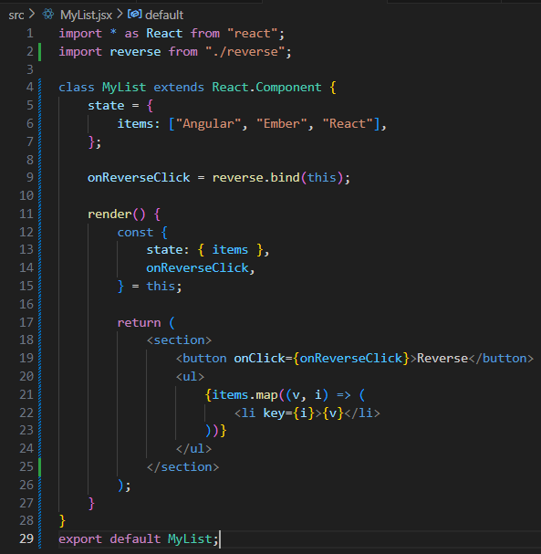

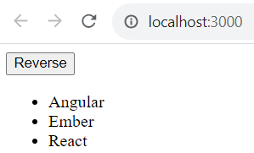
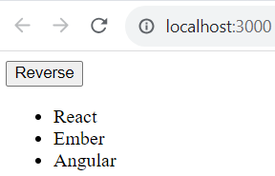
Declaring event handlers – cont’d
Importing generic handlers

Slide 8
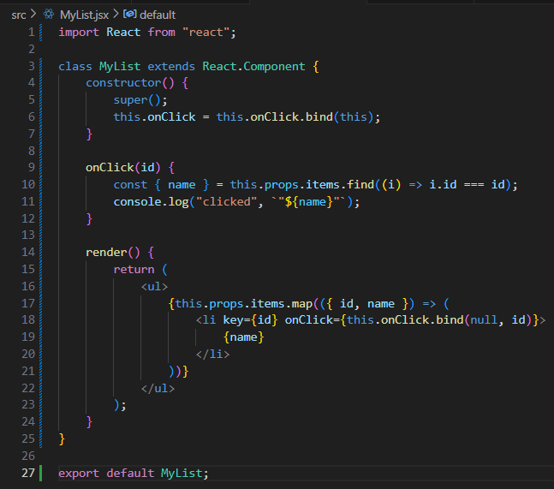
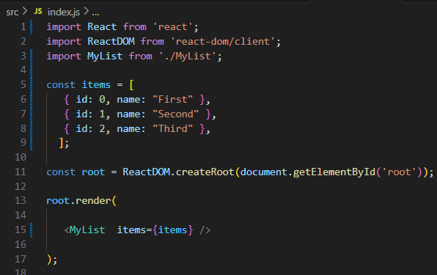
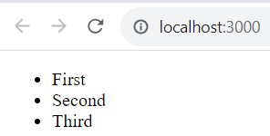

Using event handler context and parameters – cont’d
Getting component data

Slide 9
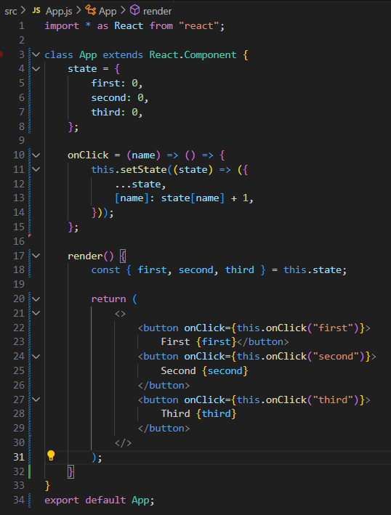
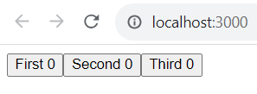
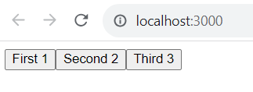
Using event handler context and parameters
Higher-order event handlers

Slide 10
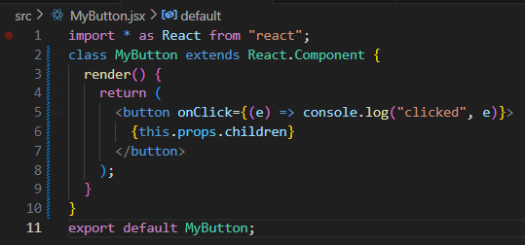
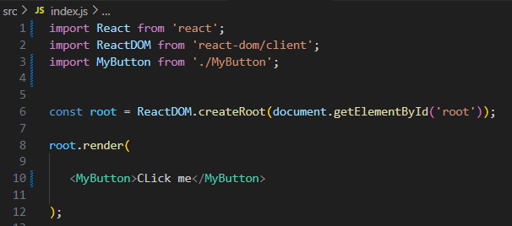
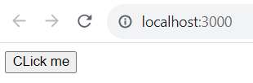

Declaring inline event handlers
The typical approach to assigning handler functions to JSX properties is to use a named function

Slide 11
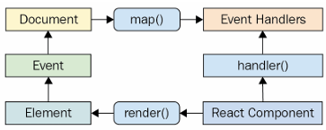
Binding handlers to elements
As events bubble up through the DOM tree to the document, the React handler checks to see whether any components have matching handlers.
The event handler cycle

Slide 12
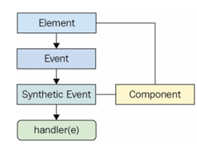
Using synthetic event objects
When you attach an event handler function to a DOM element using the native addEventListener() function, the callback will get an event argument passed to it.
Event handler functions in React are also passed an event argument, but it's not the standard Event instance.
It's called SyntheticEvent, and it's a simple wrapper for native event instances.
Synthetic events serve two purposes in React:
They provide a consistent event interface, normalizing browser inconsistencies.
They contain information that's necessary for propagation to work.
How synthetic events are created and processed

Slide 13
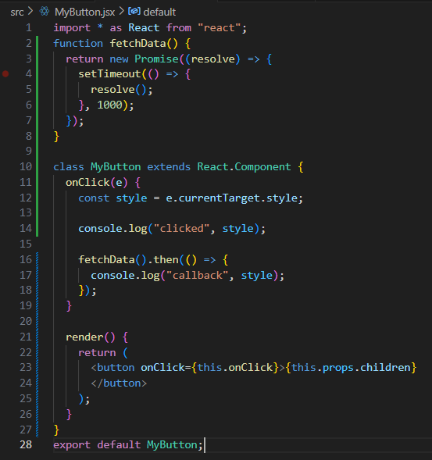
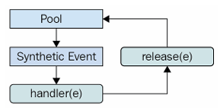
Understanding event pooling
One challenge of wrapping native event instances is that it can cause performance issues.
Every synthetic event wrapper that's created will also need to be garbage-collected at some point, which can be expensive in terms of CPU time.
Synthetic events are reused to save memory resources

Slide 14
Exercise 16: Demo about Event Handling

Slide 15
Render and Commit

Slide 16
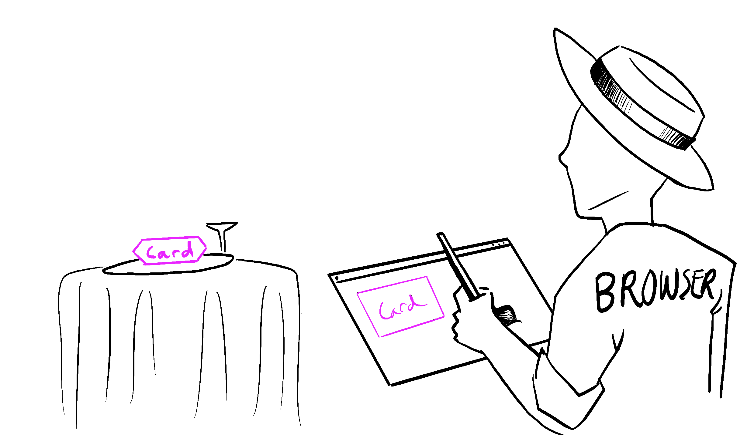
What Render and Commit?
Before your components are displayed on screen, they must be rendered by React
You will learn:
What rendering means in React
When and why React renders a component
The steps involved in displaying a component on screen
Why rendering does not always produce a DOM update

Slide 17
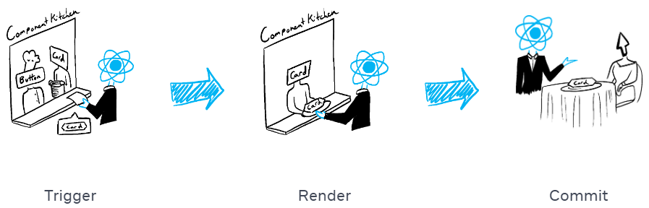
Scenario rendering
Imagine that your components are cooks in the kitchen, assembling tasty dishes from ingredients.
In this scenario, React is the waiter who puts in requests from customers and brings them their orders. This process of requesting and serving UI has three steps:
Triggering a render (delivering the guest’s order to the kitchen)
Rendering the component (preparing the order in the kitchen)
Committing to the DOM (placing the order on the table)

Slide 18

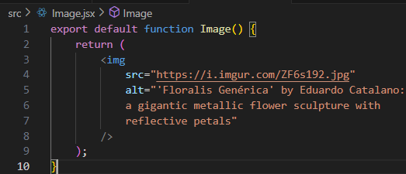
Step 1: Trigger a render
There are two reasons for a component to render:
It’s the component’s initial render.
The component’s (or one of its ancestors’) state has been updated.
Initial render
Notes:
When your app starts, you need to trigger the initial render. Frameworks and sandboxes sometimes hide this code, but it’s done by calling createRoot with the target DOM node, and then calling its render method with your component:

Slide 19
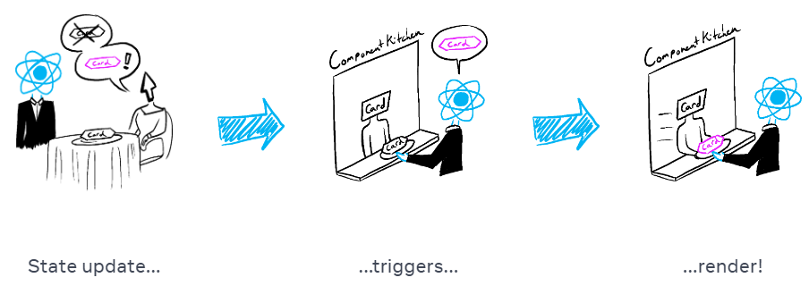
Step 1: Trigger a render – cont’d
Re-renders when state updates
Notes:
Once the component has been initially rendered, you can trigger further renders by updating its state with the set function. Updating your component’s state automatically queues a render. (You can imagine these as a restaurant guest ordering tea, dessert, and all sorts of things after putting in their first order, depending on the state of their thirst or hunger.)

Slide 20
Step 2: React renders your components
After you trigger a render, React calls components to figure out what to display on screen. “Rendering” is React calling components.
On initial render, React will call the root component.
For subsequent renders, React will call the function component whose state update triggered the render.
During the initial render, React will create the DOM nodes for <section>, <h1>, and three <img> tags.
During a re-render, React will calculate which of their properties, if any, have changed since the previous render. It won’t do anything with that information until the next step, the commit phase.
Notes:
This process is recursive: if the updated component returns some other component, React will render that component next, and if that component also returns something, it will render that component next, and so on. The process will continue until there are no more nested components and React knows exactly what should be displayed on screen.

Slide 21
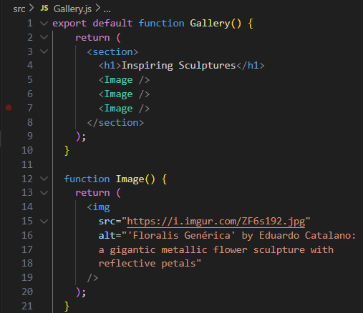

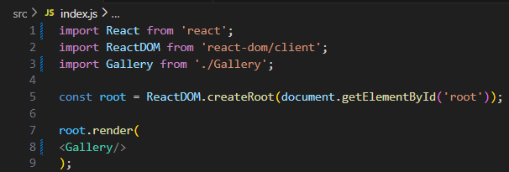
Step 2: React renders your components – cont’d
Notes:
This process is recursive: if the updated component returns some other component, React will render that component next, and if that component also returns something, it will render that component next, and so on. The process will continue until there are no more nested components and React knows exactly what should be displayed on screen.

Slide 22
Step 3: React commits changes to the DOM
After rendering (calling) your components, React will modify the DOM.
For the initial render, React will use the appendChild() DOM API to put all the DOM nodes it has created on screen.
For re-renders, React will apply the minimal necessary operations (calculated while rendering!) to make the DOM match the latest rendering output.

Slide 23
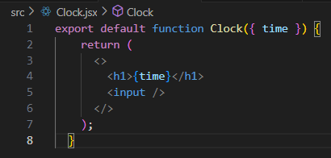
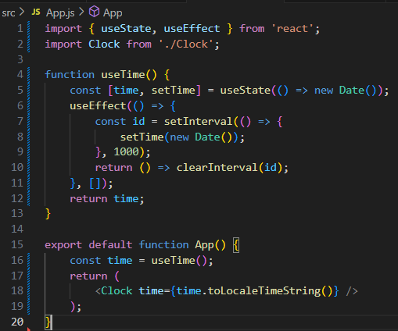
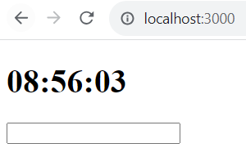
Step 3: React commits changes to the DOM – cont’d

Slide 24
Exercise 17: Demo about Render and Commit

Slide 25
State as a Snapshot

Slide 26
State behaves more like a snapshot
State variables might look like regular JavaScript variables that you can read and write to. However, state behaves more like a snapshot. Setting it does not change the state variable you already have, but instead triggers a re-render.
You will learn:
How setting state triggers re-renders
When and how state updates
Why state does not update immediately after you set it
How event handlers access a “snapshot” of the state

Slide 27
Setting state triggers renders
Setting state requests a re-render from React. This means that for an interface to react to the event, you need to update the state.
Here’s what happens when you click the button:
The onSubmit event handler executes.
setIsSent(true) sets isSent to true and queues a new render.
React re-renders the component according to the new isSent value.

Slide 28
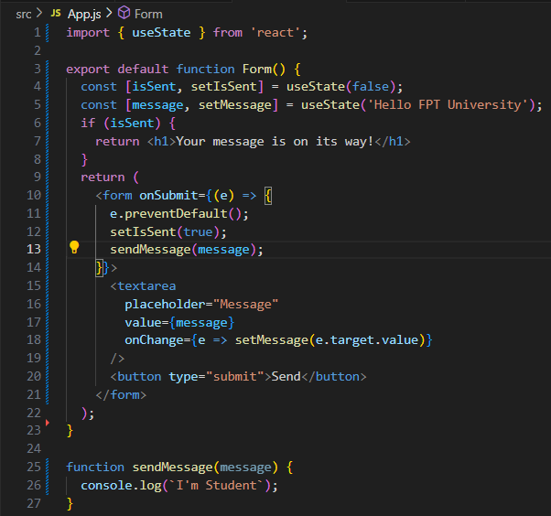
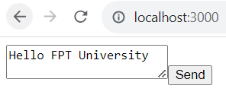
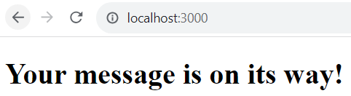
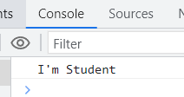
Setting state triggers renders – cont’d

Slide 29
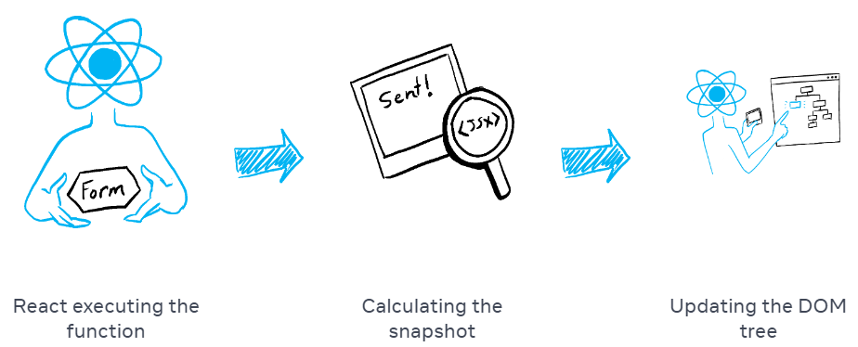
Rendering takes a snapshot in time
The JSX return from that function is like a snapshot of the UI in time. Its props, event handlers, and local variables were all calculated using its state at the time of the render.
When React re-renders a component:
React calls your function again.
Function returns a new JSX snapshot.
React then updates the screen to match the snapshot returned.

Slide 30
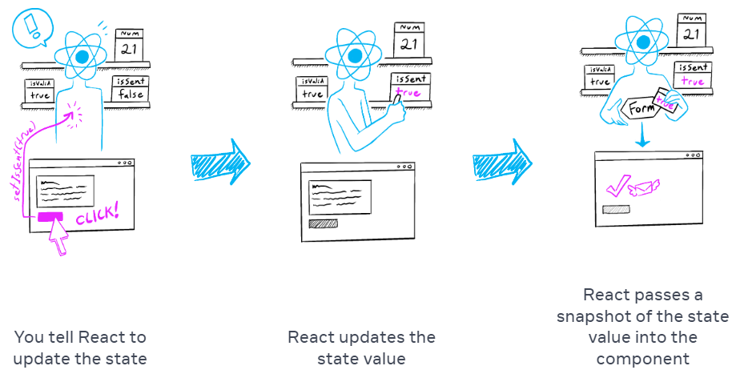
Rendering takes a snapshot in time – cont’d

Slide 31
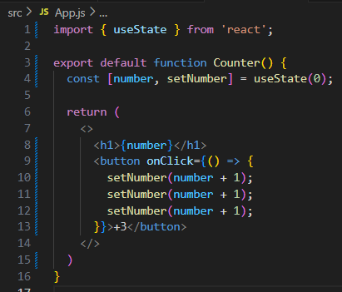
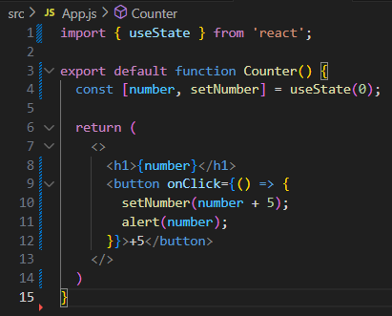
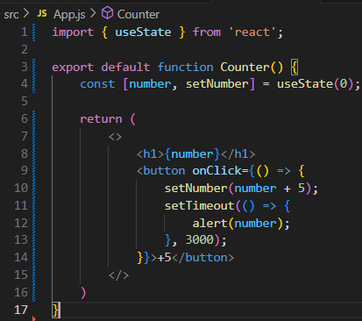
Rendering takes a snapshot in time – cont’d

Slide 32
Exercise 18: Demo about State as a Snapshot

Slide 33
Summary
Concepts were introduced:
Event Handling
Declaring event handlers
Using event handler context and parameters
Declaring inline event handlers
Binding handlers to elements
Using synthetic event objects
Understanding event pooling
Render and Commit
State as a snapshot

